Slide 1
2021 Representation review September 2021

Slide 2
What’s happened?
20 May – Council made a decision to establish Māori wards for the 2022 and 2025 local body elections
June – workshops with Council and Iwi Chairs to outline design options
June –confirmed preferred option for new Council representation structure
July-August –engagement hui on process and proposed new structure
17 August – Council decided its initial proposal for public consultation
30 August to 6 October submission period

Slide 3
What is a representation review?
Legal process conducted under the Local Electoral Act 2001 (LEA)
Must undertake a review at least every six years
Decides the total number of councillors
the number of wards, their boundaries, names and number of councillors elected to each
Community boards – how many, names, boundaries, subdivisions, number elected or appointed to each

Slide 4
Principles of a representation review
Under the Local Electoral Act representation arrangements must provide for fair and effective representation
Effective representation = communities of interest effectively represented
Fair representation = each elected member represents about the same number of people (within +/-10%), using most current population data

Slide 5
Population data used
 |  | Estimated Resident Population at 30 June 2020
District | Ward | Māori Electoral Population (MEP) | General Electoral Population (GEP)
Whakatane district | Rangitaiki ward | 3,530 | 7,620 | 11,150
 | Whakatane-Ōhope ward | 4,850 | 14,600 | 19,450
 | Taneatua-Waimana ward | 2,460 | 1,590 | 4,050
 | Galatea-Murupara ward | 2,240 | 1,310 | 3,540
 |  | 13,080 | 25,120 | 38,190

Slide 6
Proposed new Council representation structure
Ten Councillors in total = 3 Māori ward and 7 general ward councillors (plus the Mayor)
The key changes are:
Separate general wards and Māori wards
General ward boundary adjustments
Seven general ward councillors elected from three general wards
Three Māori ward councillors elected from three Māori wards
Six elected members for each community board

Slide 7
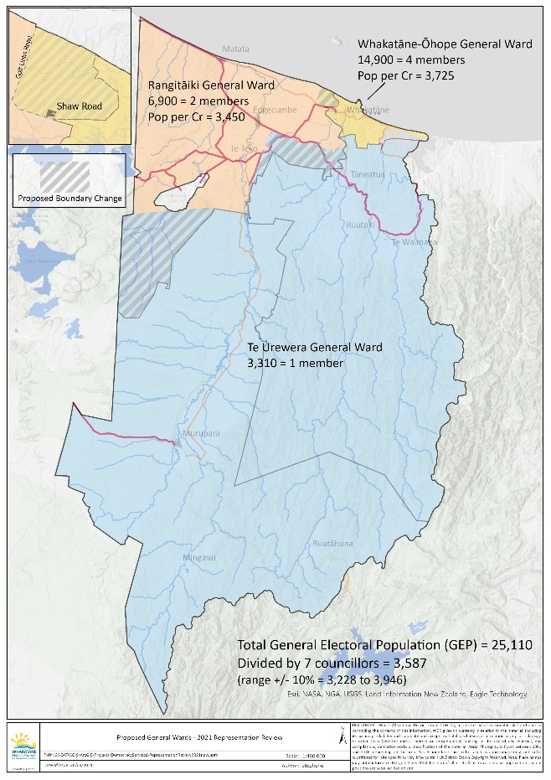
Proposed general wards
7 councillors from 3 general wards
Rangitāiki General Ward (2)
Whakatāne-Ōhope General Ward (4)
Te Urewera General Ward (1)

Slide 8
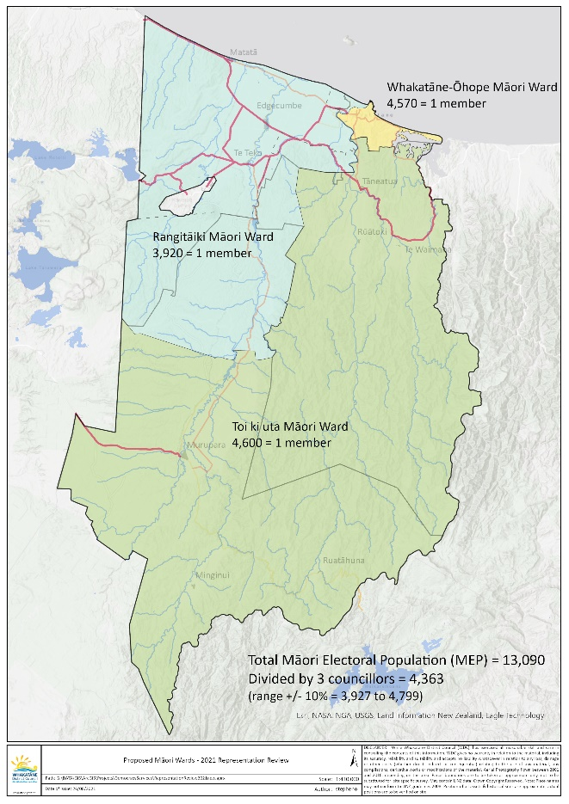
Proposed Māori wards
3 councillors from 3 Māori wards
Rangitāiki Māori Ward (1)
Whakatāne-Ōhope Māori Ward (1)
Toi ki uta Māori Ward (1)

Slide 9
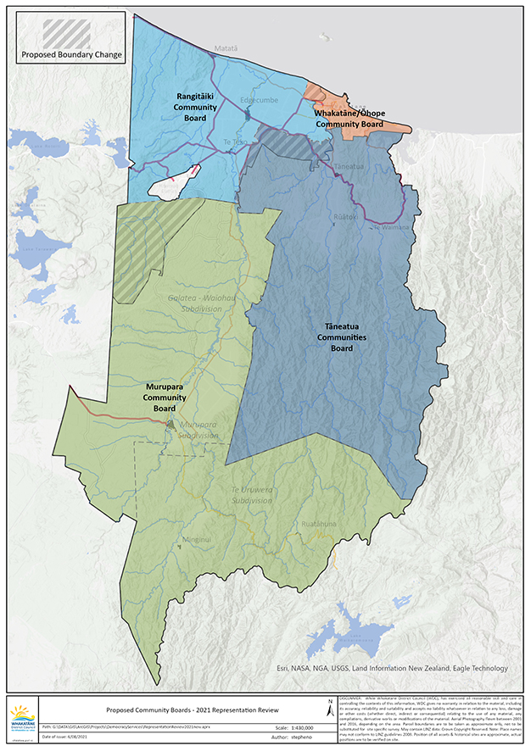
Proposed Community board structure
24 community board members elected from 4 community boards
Community board boundaries align with proposed general ward boundaries:
Rangitāiki Community Board (6 + 1 councillor)
Whakatāne-Ōhope Community Board (6 + 1 councillor)
Tāneatua Communities Board (6 + 1 councillor)
Murupara Community Board (6 + 1 councillor)
- Galatea-Waiōhau Subdivision (2)
- Murupara Subdivision (3)
- Te Urewera Subdivision (1)

Slide 10
Who can stand?
To be eligible to stand for election (in either a general or Māori ward) a candidate must be:
A New Zealand citizen (by birth or citizenship ceremony)
Enrolled as a Parliamentary elector (anywhere in New Zealand)
Nominated by two electors whose names appear on the electoral roll within the area the candidate is standing in. Candidates standing in Māori wards do not have to be of Māori descent
Candidates cannot stand for general and Māori wards at the same time

Slide 11
Who can vote, and how?
Voters on the Māori electoral roll will vote for candidates standing in the Māori wards
Voters on the general electoral roll will vote for candidates standing in the general wards
Everyone will vote for the Mayor and community board members in the ward area

Slide 12
Enrolling to vote
18 years or older, a NZ citizen or permanent resident, and you’ve lived in NZ continuously for 12 months or more at some time in your life
Enrol online, you need to verify your identity using 1 of these ways
Your New Zealand driver licence
Your New Zealand passport
Your RealMe verified identity
If you’re of Māori descent and enrolling for the first time you need to decide which electoral roll you want to be on: the general roll or the Māori roll. The roll you choose decides which electorate/ward you vote in. Identifying as Māori is self-determining and no proof is required
You can change rolls (Māori or general) during the next Māori Electoral Option in 2024. The Maori electoral option occurs every 5 years (after each 5-yearly population census). However the government is considering a law change, to alter the timing and frequency of the Māori Electoral Option – watch this space for change!
Electoral Commission website https://vote.nz/enrolling/enrol-or-update/enrol-or-update-online/

Slide 13
Next steps
30 August to 6 October - submission period
14 October - Council hearing of submissions, and deliberations
11 November - Council meeting to decide final proposal

