Slide 1
E-LEARNING

Slide 2
Whakatauki
He kai kei aku ringa
There is food at my hands

Slide 3
Disclaimer:​
The information included in this e-learning hub has been compiled by the Whakatāne District Council to help us and our community on a journey of learning and development. The Council does not own and is not the authors of most of the content included in this hub. The Council has compiled content that we felt to be relevant, engaging and wherever possible to provide a local context. Further information regarding Council’s Climate Change Principles, our Climate Change project or our current engagement opportunities can we found on our project page:​
https://www.whakatane.govt.nz/climate-change

Slide 4
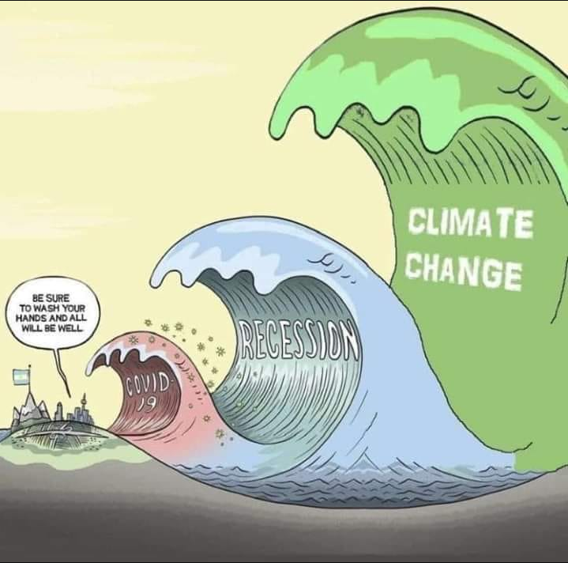
Module 4: Tools for our response
Topics covered in this module:
1. Circular economies:
1.1. The Ellen MacArthur Foundation
1.2. A solution to build back better: the circular economy
1.3. The biggest myths around circular economies.
1.4. An example of circular economies in action
2. The DAPP-model (Dynamic Adaptive Pathways Planning) and how to use this model to guide our decision-making
2.1. Deep South Challenge Research: Supporting decision making through adaptive tools in a changing climate
3. What’s the deal with carbon?
3.1. Carbon concentrations in the atmosphere have increased over time
3.2. Transitioning into a low emission economy
3.3. Carbon pricing, explained with chickens
3.4. The NZ Emission Trading Scheme (ETS)
3.5. The Carbon Landscape Theory
3.6. Count your carbs
3.7. What can you do to reduce your carbon footprint
3.8. COVID-19 and carbon emissions
Learning statement for this module
What tools can we use to mitigate our emissions and environmental impact and be adaptive in our decision-making?
Followed by a short survey to reflect on your comfort levels with the concepts covered in this module.

Slide 5
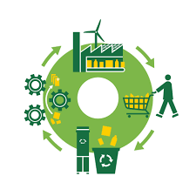
1. Circular economies
The essential concept at the heart of the circular economy is to ensure we can unmake everything we make.
Growing international research and evidence shows numerous benefits over the traditional linear economy.
These include:
Long-term cost savings
Increased local job opportunities
Encouragement of technical innovation
Reducing the amount of harmful waste produced
Reversing our impacts on climate change.
When a product’s component materials are reused rather than put in a landfill, not only is that material no longer waste but new raw materials are not required to be extracted.
https://youtu.be/zCRKvDyyHmI (12.05.2020)
4min

Slide 6
1.1. The Ellen MacArthur Foundation
The Ellen MacArthur Foundation works to inspire a generation to re-think, re-design and build a positive future circular economy
“What do you learn when you sail around the world on your own? When solo sailor Ellen MacArthur circled the globe – carrying everything she needed with her – she came back with new insight into the way the world works, as a place of interlocking cycles and finite resources, where the decisions we make today affect what's left for tomorrow. She proposes a bold new way to see the world's economic systems: not as linear, but as circular, where everything comes around.”
https://youtu.be/ooIxHVXgLbc (12/05/2020)
15min
More information on the Ellen MacArthur Foundation:
https://www.ellenmacarthurfoundation.org/

Slide 7
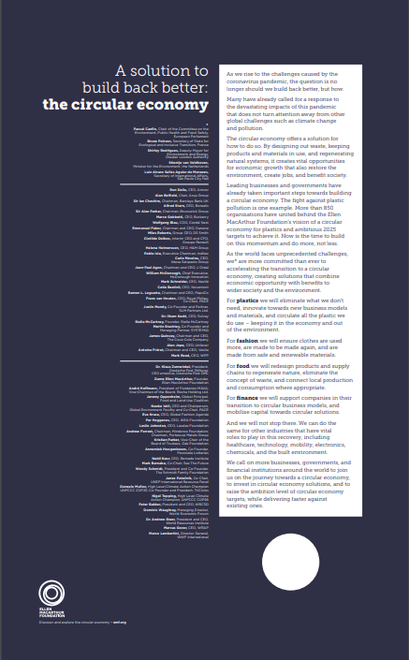
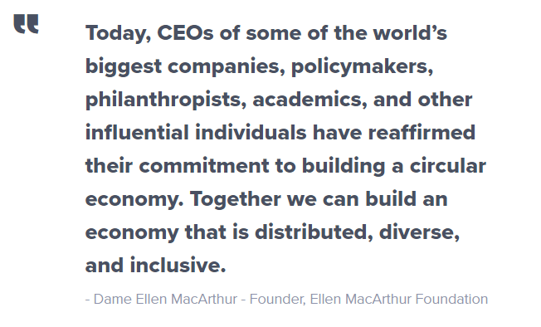
1.2. A solution to build back better: the circular economy
Policymakers, CEOs, and other influential individuals are highlighting the circular economy as a solution to build back better in response to the economic impact of the coronavirus pandemic.
As the world faces unprecedented challenges, the signatories have stated that they are more committed than ever to accelerating the transition to a circular economy — creating solutions for plastics, fashion, food, finance, and beyond that combine economic opportunity with benefits to wider society and the environment.
The statement further calls on businesses and governments around the world to join the journey towards a circular economy — to invest in circular economy solutions and raise the ambition level of circular economy targets.
It’s time to step up, not step back.
Read the full statement:
https://www.ellenmacarthurfoundation.org/assets/downloads/emf-joint-statement.pdf

Slide 8
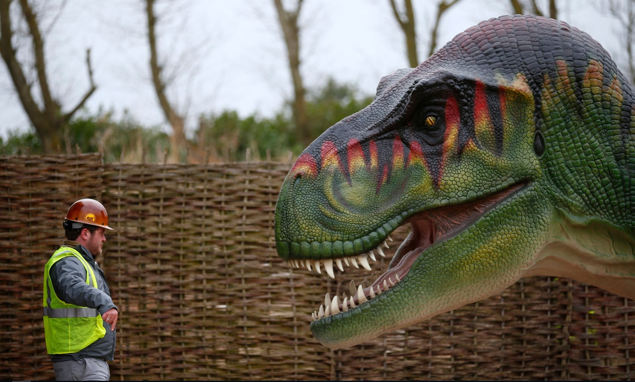
1.3. The biggest myths around circular economies
Extract from the article:
“Perception: the circular economy is just another way to describe recycling
Reality: The circular economy is much more than recycling. A linear economy makes, uses and disposes materials. The circular economy looks at all the options across the chain to use as few resources as possible in the first place, keep resources in circulation for as long as possible, extract the maximum value from them while in use, then recover and regenerate products at the end of service life. This means designing products for longevity with repairability in mind so that materials can be easily dismantled and recycled, not to mention the alternative business models that encompass trade-ins, sharing models and service packages.”
Read the full article here:
https://www.theguardian.com/sustainable-business/2015/mar/12/circular-economy-myths-busted-reality-check

Slide 9
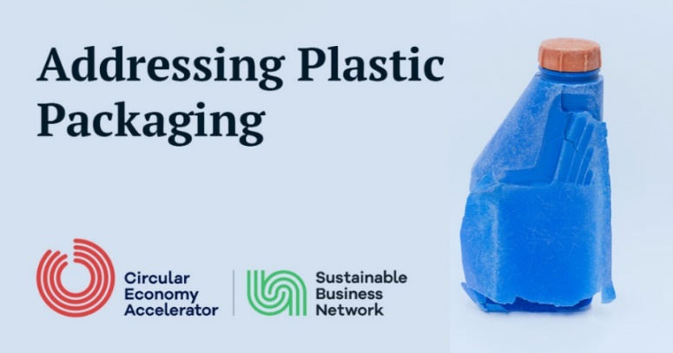
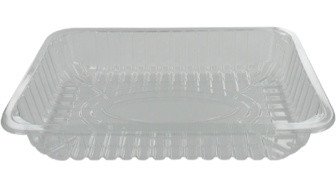
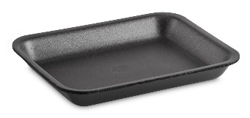
1.4. An example of circular economies in action
The Sustainable Business Network: Plastic Packaging Circular Innovation Programme:
https://sustainable.org.nz/plastic-packaging-circular-innovation-programme/
https://www.youtube.com/watch?v=kkKTvCTL1SA#action=share (19/06/2020)
5min

Slide 10
2. The DAPP-model (Dynamic Adaptive Pathways Planning) - and how to use this model to guide our decision-making
This is the method the Ministry for the Environment recommends local government uses for decision-making. The DAPP-model is sometimes also referred to as the Dynamic Adaptive Policy Pathways –model although the Dynamic Adaptive Pathways Planning terminology is more commonly used in NZ.
https://youtu.be/yLS4PubQVgc (21/04/2020)
Deltares is an independent institute for applied research in the field of water and subsurface. Throughout the world, they work on smart solutions, innovation and applications for people, environment and society.
4min

Slide 11
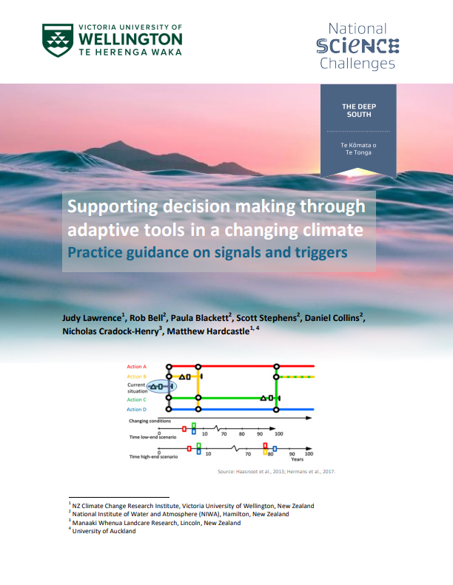
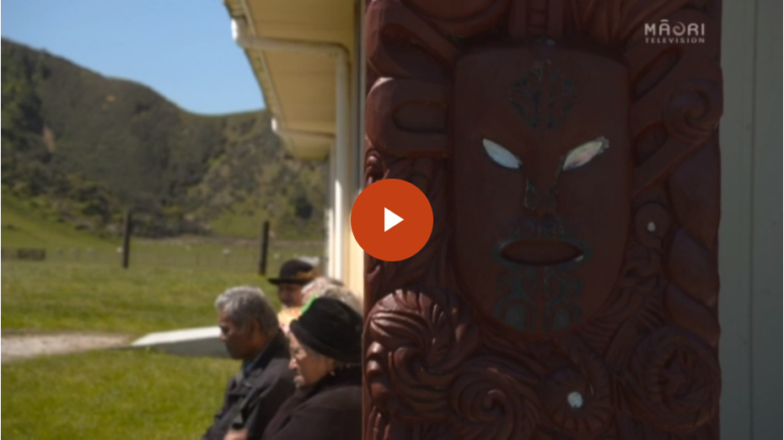
2.1. Deep South Challenge Research: Supporting decision making through adaptive tools in a changing climate
“As an island nation with high rainfall, flooding and sea level rise pose threats to economic and social activities on floodplains and at the coast. Decisions in such locations need to be adaptive, to recognise when thresholds may be crossed and to deal with changes before they happen. In this way, decision makers can avoid or reduce the consequent damage and costs”
Deep South Challenge has written a report on the use of DAPP for those more interested in the subject:
https://www.deepsouthchallenge.co.nz/sites/default/files/2020-03/Supporting%20decision%20making%20through%20adaptive%20tools%20in%20a%20changing%20climate%20Practice%20guidance%20on%20signals%20and%20triggers.pdf
This research featured in the media (link contains a video):
https://www.teaomaori.news/hapus-quest-save-their-marae
7min

Slide 12
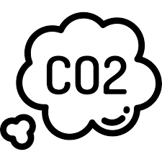
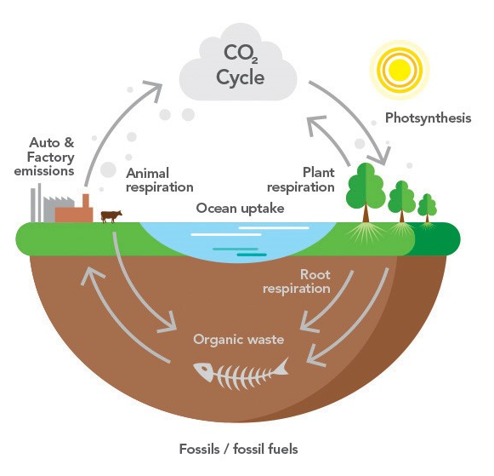
3. What’s the deal with carbon?
What is the carbon cycle and how is it affected by human activities?
https://www.youtube.com/watch?v=2Jp1D1dzxj8 (19/06/2020)
3min

Slide 13
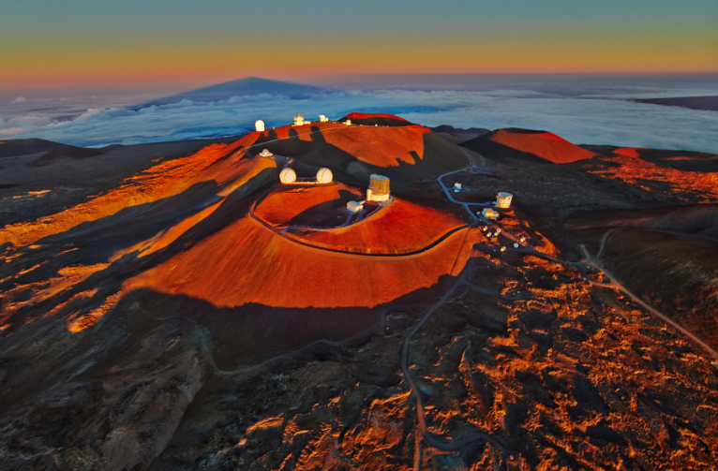
3.1. Carbon concentrations in the atmosphere have increased over time
“This visualization is a time-series of the global distribution and variation of the concentration of mid-tropospheric carbon dioxide observed by the Atmospheric Infrared Sounder (AIRS) on the NASA Aqua spacecraft. For comparison, it is overlain by a graph of the seasonal variation and interannual increase of carbon dioxide observed at the Mauna Loa, Hawaii observatory”
https://www.youtube.com/watch?v=UatUDnFmNTY (19.06.2020)
Pictured: The Mauna Loa observatory in Hawaii
2min
“Atmospheric carbon dioxide measured at Mauna Loa Observatory reached a seasonal peak of 417.1 parts per million for 2020 in May, the highest monthly reading ever recorded”
CIRES is the Cooperative Institute for Research in Environmental Science at the University of Colorado Boulder
Learn more about the CIRES research
https://cires.colorado.edu/news/rise-carbon-dioxide-unabated

Slide 14
3.2. Transitioning into a low emissions economy
A low emission economy is by definition:
“An economy based on low carbon power sources that therefore has a minimal output of greenhouse gas (GHG) emission into the atmosphere, specifically referring to the greenhouse gas carbon dioxide”.
The Productivity Commission investigated the challenges of, and identified opportunities for, reducing New Zealand’s emissions in the context of an ambition to achieve net-zero emissions by 2050.
Find the summary report and full report below:
https://youtu.be/ja75QgXuZyk (14.05.2020)
2min
The report at a glance (4 pages): https://www.productivity.govt.nz/assets/Documents/28a35c5734/At-a-glance_Low-emissions-economy-v2.pdf
The full report (620 pages): https://www.productivity.govt.nz/assets/Documents/4e01d69a83/Productivity-Commission_Low-emissions-economy_Final-Report.pdf

Slide 15
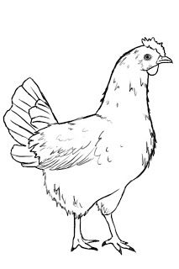
3.3. Carbon pricing, explained with chickens
Carbon pricing is an approach to reducing greenhouse gas emissions that uses market mechanisms to pass the cost of emitting on to emitters.
The broad goals is to discourage the use of carbon dioxide – emitting fossil fuels in order to protects the environment, address the causes for climate change, and meet national and international climate agreements.
https://youtu.be/zD64kaTY5Vg (14.05.2020)
3min

Slide 16
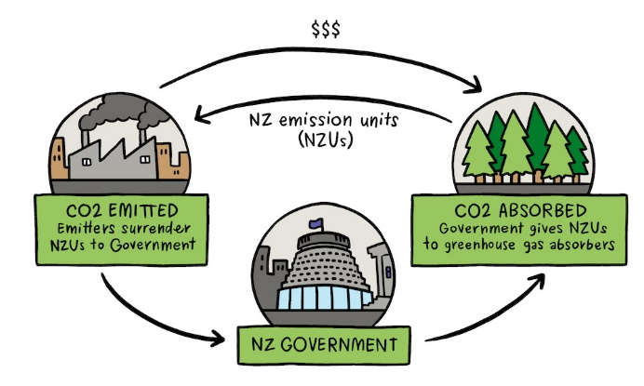
3.4. The New Zealand emission trading scheme (ETS)
A carbon credit is a generic term for any tradable certificate or permit representing the right to emit one tonne of carbon dioxide or the equivalent amount of a different greenhouse gas (tCO2e).
tCO2e = the amount of another greenhouse gas that does as much damage as one tonne of carbon dioxide.
The New Zealand Emission Trading Scheme (ETS) puts a price on greenhouse gas emissions.
It creates a financial incentive for:
Businesses to reduce their emissions
Landowners to earn money by planting forests that absorb carbon dioxide as the trees grow.
One emission unit, the New Zealand Unit, represents one metric tonne of carbon dioxide or carbon dioxide equivalent (tCO2e).
https://youtu.be/1GtMJEQPCHk (14.05.2020)
8min
More on the NZ emission trading scheme can be found here: https://www.mfe.govt.nz/ets

Slide 17
The Māori Carbon Collective (MCC) on the ETS
2min
https://www.youtube.com/watch?v=11RtLN1y98g&feature=youtu.be (17/11/2020)
Learn more about the Māori Carbon Collective: https://www.maoricarbonfoundation.com/

Slide 18
3.5. The Carbon Landscape Theory
Craig Pocock is an award winning landscape architect born and bred in NZ. He used to work in Whakatāne in his early career, has since travelled the world and nowadays lives in Wellington.
The one hour keynote covers: 1. The carbon cost of landscape architecture and urban design. 2. How it is almost impossible to offset carbon design costs with trees and the imbalance between design and the natural environment. 3. Where the carbon costs sit within the design, materials, implementation and maintenance stages. 4. The high carbon cost of urban renewal and why poor design leads to urban renewal. How to avoid poor urban design and the urban renewal trap. 5. The carbon cost of urban storm water management and low impact storm water design. 6. How to reduce carbon costs through the free market by acting as a climate responsive design collective. 7. The role of social programming in reducing urban renewal and the high associated carbon cost. 8. Summary of possible carbon mitigation solutions for clients and designers.
https://www.youtube.com/watch?v=I5LvYXD-PnI&t=464s (18/06/2020)
1h
Learn more about the Carbon Landscape Collective:
https://www.landscapearchitecture.nz/landscape-architecture-aotearoa/2019/1/30/the-carbon-landscape-managing-the-impact-of-landscape-architecture

Slide 19
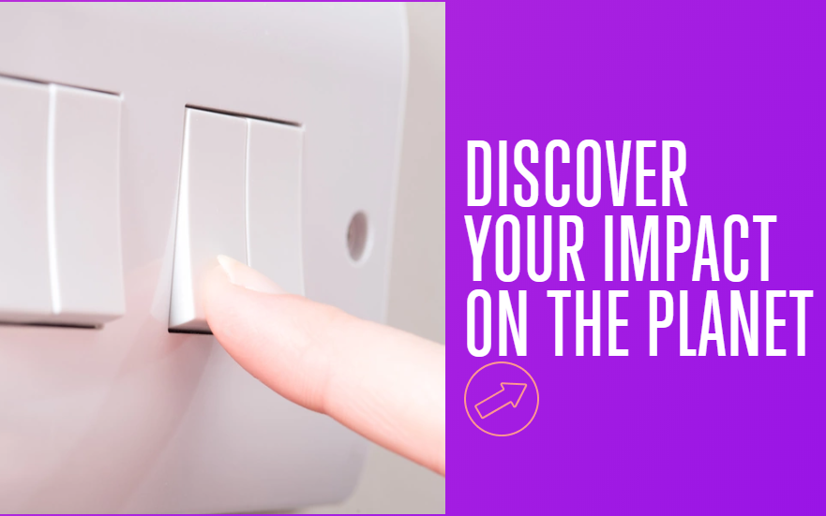
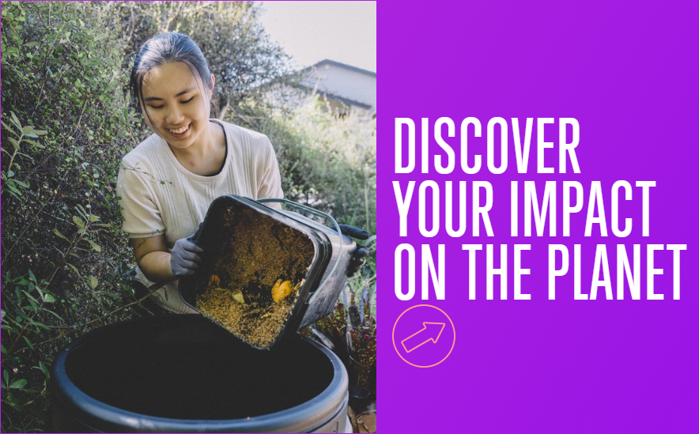
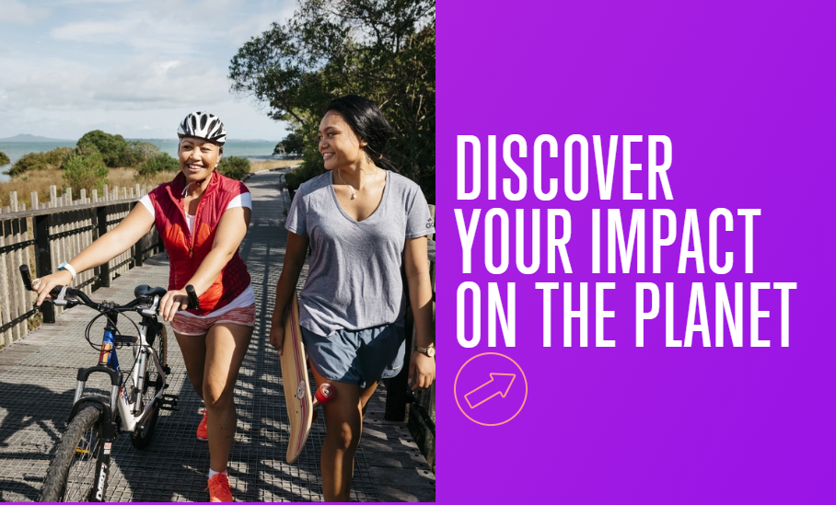
3.6. Count your carbs – calculate your own carbon footprint
https://www.futurefit.nz/

Slide 20
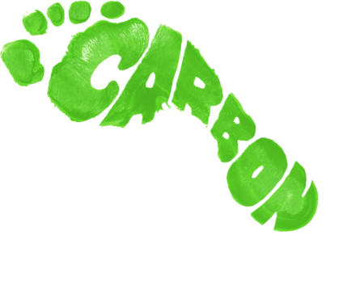
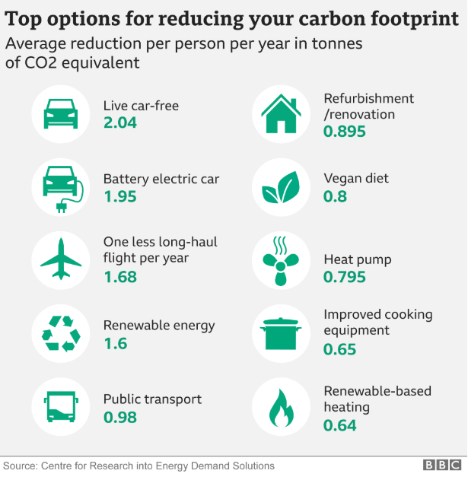
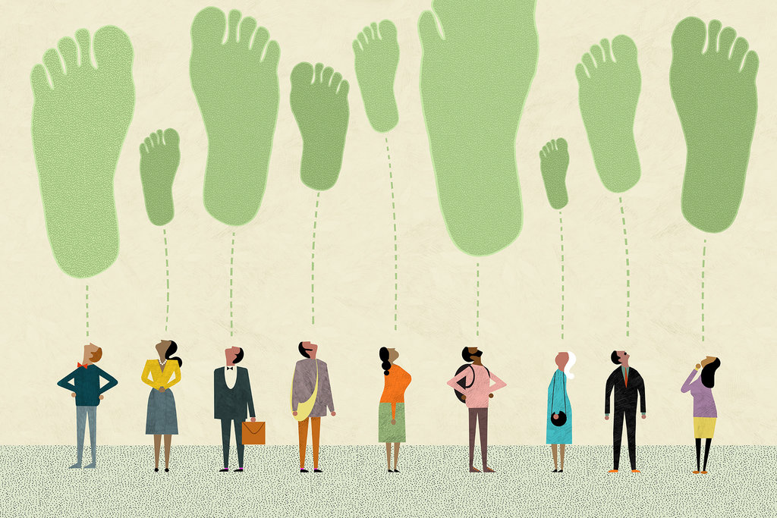
3.7. What can you do to reduce your carbon footprint?
There are small changes all of us can take to tackle climate change in our everyday lives.
Adding these up together, we can make a real difference.
Two places you can start:
BBC News: Climate Change – Top 10 tips to reduce carbon footprint revealed
https://www.bbc.com/news/science-environment-52719662
Ministry for the Environment - What you can do about climate change
https://www.mfe.govt.nz/climate-change/we-all-have-role-play/what-you-can-do-about-climate-change

Slide 21
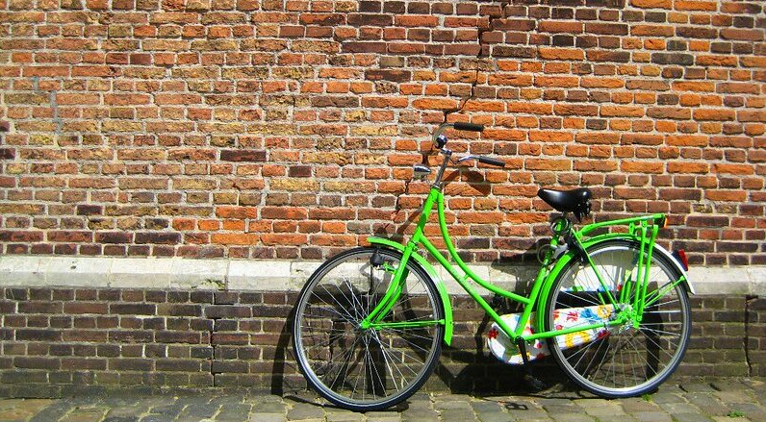
3.8. Covid-19 and carbon emissions
Coronavirus has already begun to reshape the environment in dramatic ways, from decreased air pollution to animals roaming city streets.
But how will COVID-19 affect the future of our response to climate change, and what has it taught us about how to fight a global crisis?
https://youtu.be/E67saMacI74 (22/05/2020)
The Thomas Reuters Foundation is a global news and information services company that work to advance media freedom, raise awareness of human rights issues and foster more inclusive economies
9min

Slide 22
Covid-19 and carbon emissions (cont.) - Why COVID-19 might not be so good news for the climate after all
11min
https://youtu.be/qqmX9y0NozE (15.05.2020)

Slide 23
Bonus track on the NZ ETS ☺
https://youtu.be/eOWlcR_kM9o (14.05.2020)
5min

Slide 24
Module 4 survey https://survey.alchemer.com/s3/6035992/Module-4-Tools-for-our-response-public-survey

Slide 25
Final thoughts… New Zealand – Facing the truth of climate change
https://www.youtube.com/watch?v=Oxg7ULAlt_Y&feature=youtu.be (19/06/2020)

Slide 26
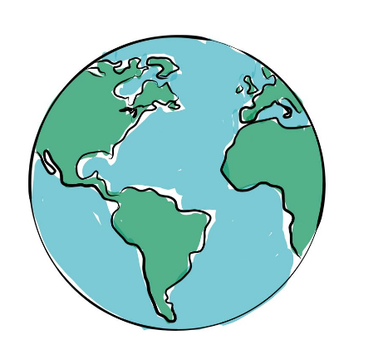
Thank you for completing Council’s climate change e-learning course. Hope you have learnt lots and had a great time!

