Slide 1
Whakatāne District Recovery
Kia manawanui

Slide 2
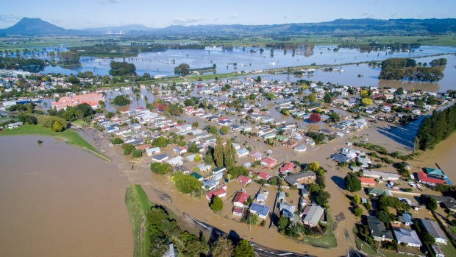
Key events
1600 evacuated from Edgecumbe
Large impact on roading and isolation in rural communities
Notes:
Te Whāiti Road - From start of Gorge to Te Whāiti
Early August 2017
Targeting access for local traffic by early to mid-June, with full public access by early August.
Transportation and Road Closures
Te Whāiti Road has been closed since 6 April as a result of massive damage caused by cyclone Debbie, which left the road blocked or impassable in at least 15 places. Contractor crews have since re-established limited access so they can get earthmoving machinery in to the affected areas but it is not safe for public access; as soon as safe access has been restored, the road will be re-opened.
Access status for the Minginui and Te Whāiti communities is as follows:
There are still seven stretches of Te Whāiti Road with only marginal, single-lane access available, where the risk to non-contractor traffic is too high to allow public access. This relates to the threat of accidents with trucks and earthmoving equipment; and poor sight-lines, which mean there is a greater risk of head-on accidents on corners.
Five contractor crews are working extended hours and access through these areas is available under strictly controlled circumstances for emergency services only.
Access to and from Murupara is via Timberlands’ forestry roads. Work has been done to improve the road surface and signage. The key health and safety message when driving on forestry roads is: “Drive to the conditions and travel at a speed that allows you to stop within half the visible distance in front of you.”

Slide 3
Response
Following severe inundation and storm damage due to ex-Tropical Cyclones Debbie (5/4/2017), and Cook (13/4/2017):
First declaration on 6 April for Whakatāne District,
Bay of Plenty was been placed in a state of emergency on 11 April and terminated on 14 April.
Replaced by a Whakatāne District state of emergency which began at 1200hrs 14/4/2017 and was enforce for 7 days until 21 April 2017.

Slide 4
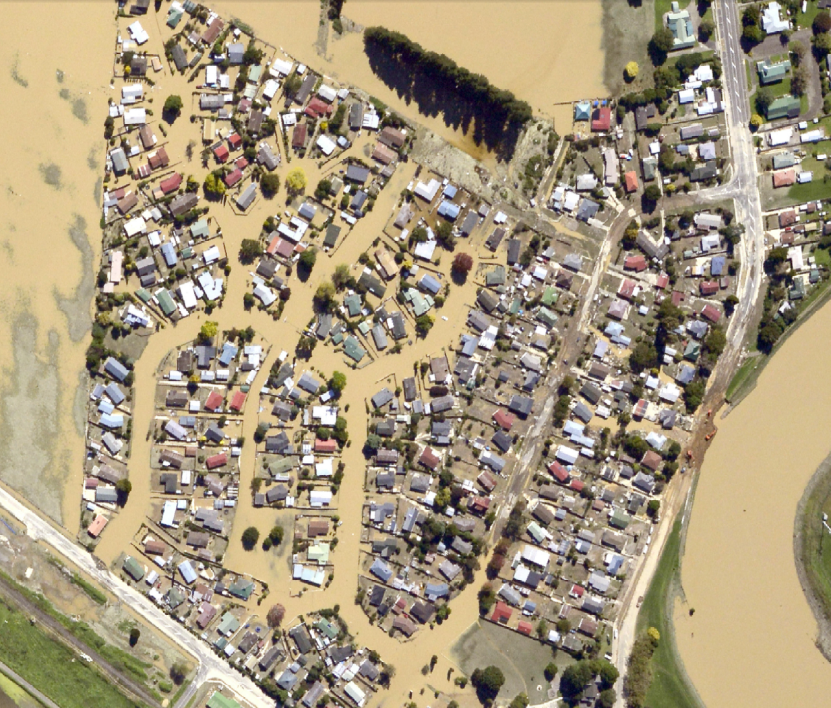
8 April 2017
Notes:
Two days after the breach – Matahina reduced flow to allow four hour window for teams to get into repair the breach

Slide 5
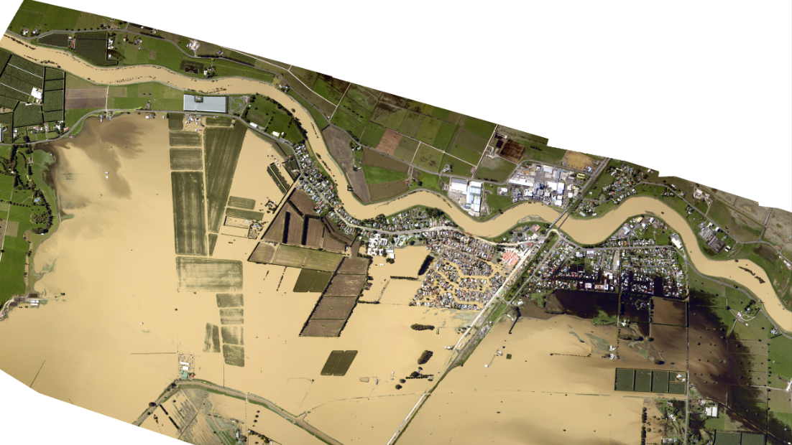
8 April 2017
Notes:
Overall picture of the plains area and the flow of water out across the plains and then back up to the South end of town

Slide 6
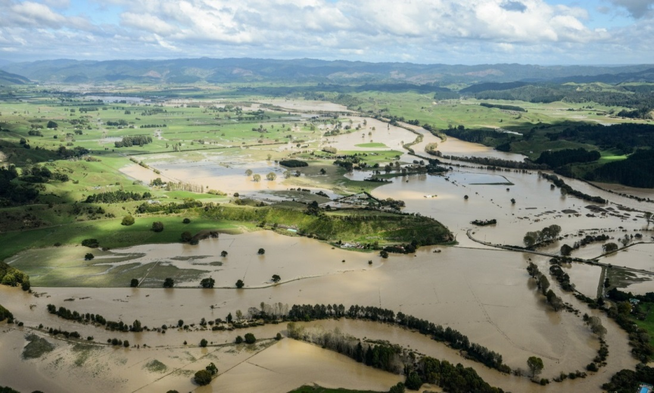
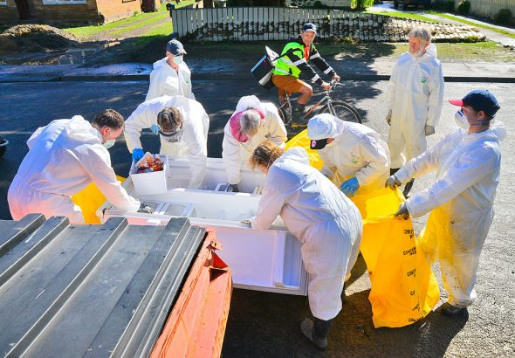
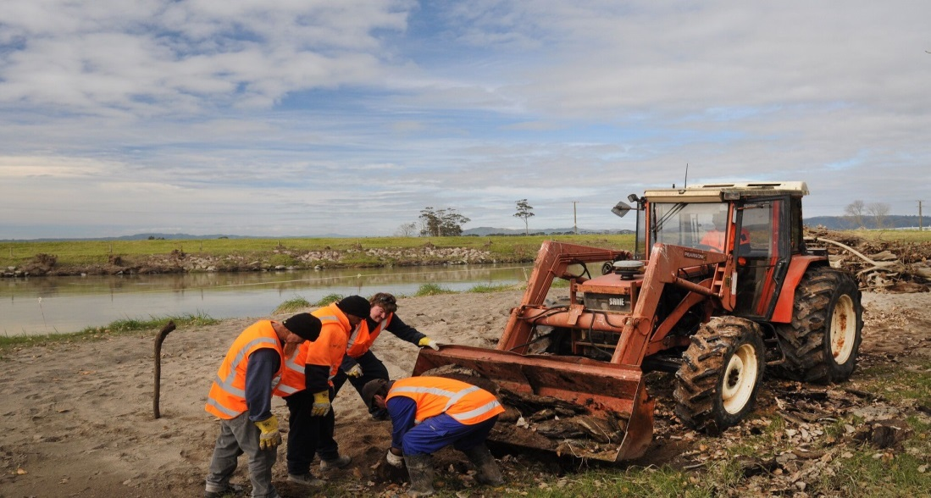
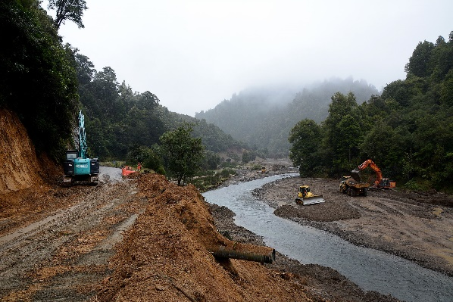
Ma tini ma mano ka rapa te whai.
By many, by thousands, the work (project) will be accomplished.
RECOVERY
Notes:
Recovery is about a coordinated effort with agencies, groups, families to get our communities back up and running.
Recovery office was staffed by a lot of different agencies including EQC, Work safe, Fed Farmers and Rural support trust.
New faces roaming building

Slide 7
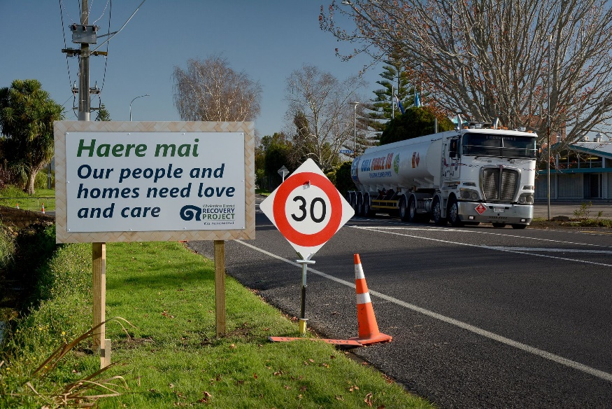
Recovery objective
Restore and create opportunities to enhance our community wellbeing.
Notes:
This is the overarching goal for recovery.
It is about putting people and the community at the heart of our planning.
It is about getting people back into their homes, it is about making people feel safe, and it is about, supporting businesses and farmers, being future focused and making the most of opportunities that could make things better.
Looking for opportunites e.g. insultation

Slide 8
Reconnect Tūhononga
Restore Whakahou
Rebuild Waihanga
Regenerate Whakatipu
Working in partnership with Iwi
Notes:
Framework for Recovery work Programme
5 environments

Slide 9
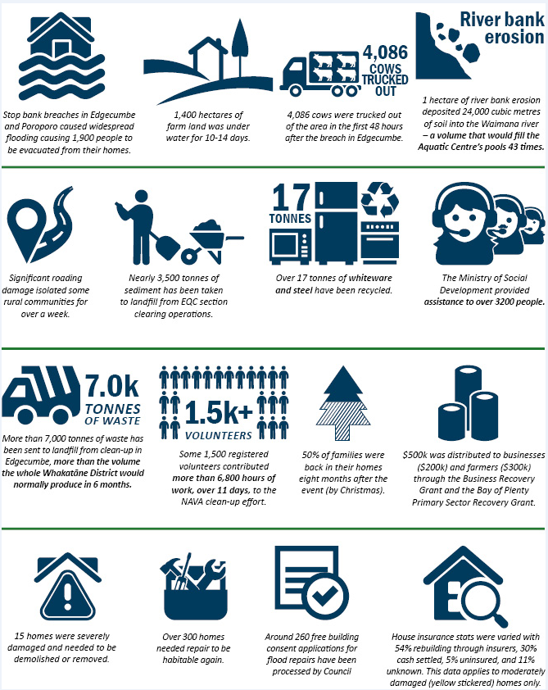
Some statistics
Notes:
Updated info graphic

Slide 10
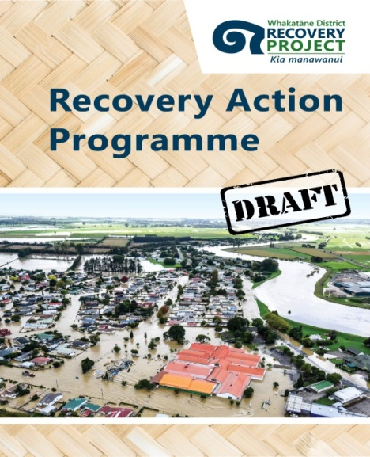
Work Programme
Workplan to rebuild our communities
Includes objectives, outcomes, success factors, milestones, and indicative timelines
Notes:
Recovery Programme is a living document that provides a pathway for rebuilding our communities in a future-focused way.
Programme is grouped into 4 environments:
Built
Economic,
Community
Natural and rural.
Each environment has a set of objectives, success factors and milestones.

Slide 11
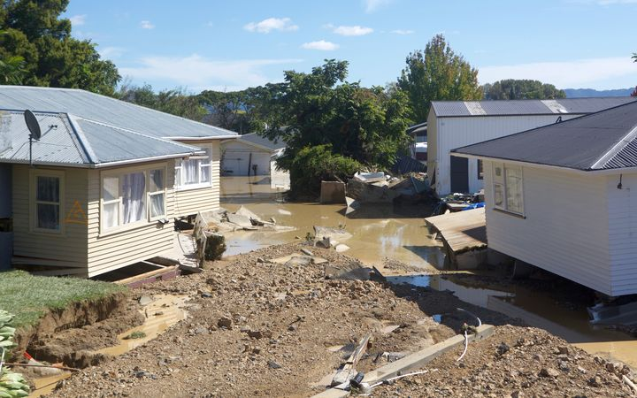
Rebuild – Waihanga
REPAIRING OUR HOMES AND RESTORING OUR COMMUNITIES
Red stickered properties (15) to be removed / demolished
Over 300 homes needed repair to be habitable again.
60% home by Feb 2018
Nearly 3,500 tonnes of sediment from EQC clearance of sections
Notes:
About 303 yellow stickered for the district. We have monitored people moving back home – and the latest tally is 60% . Milestone is 90% before xmas – didn’t quite make this for a numbe rof reasons (rain, people taking time to decide – life choices etc.!
15 red stickered properties
Aside from Edgecumbe homes, biggest impact on the district has been the roading network – long work programme in place for repairs

Slide 12
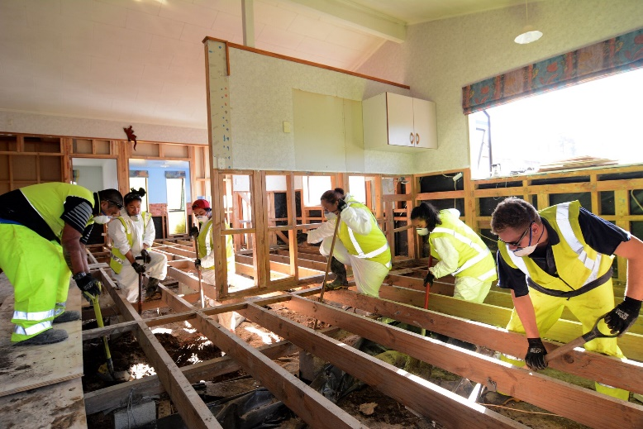
Liveable homes
Stage 1: 15 homes signed up for strip, dry and repair to a ‘liveable’ standard – all complete
Approx. 200 registered for insulation
Stage 2: Building Navigators assisting the underinsured
Notes:
Project aimed at supporting those that don’t have the means to repair houses themselves to assist to get homes repaired to a standard where they are ‘liveable’.
Drying and repair took longer than expected (wet weather doesn’t help with the drying process).
LHP also has wider benefit for all flood affected homes, regardless of financial situation. Free of charge building inspections, code of compliance certificates and insulation
Community funding
Denoted materials
Heavily discounted goods
– some materials only, others full LHP
Stage 2 has now been commenced

Slide 13
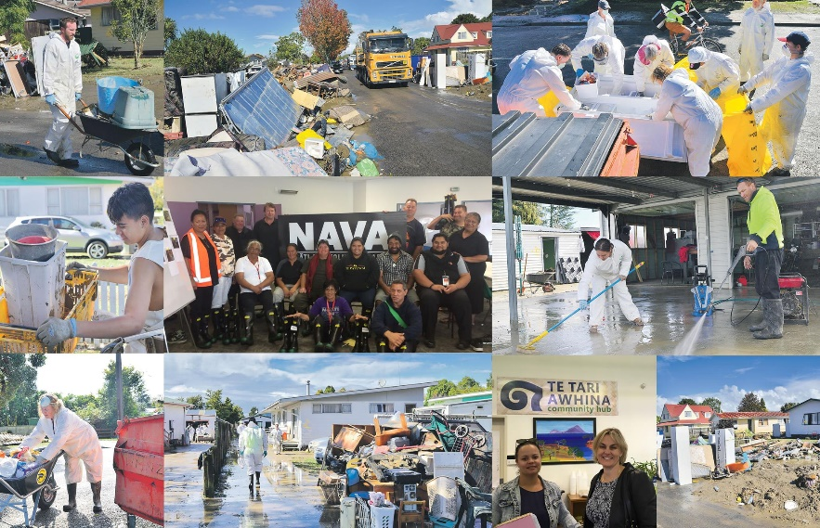
Reconnect - Tūhononga
RECONNECTING OUR COMMUNITY
Navigators (over 300 families)
Mayoral relief fund
Recovery related events and expos
Community plan
Temporary accommodation
Notes:
Whakatane District Mayoral Relief Fund ($169,272)
Navigators Programme introduced to provide medium-term support for those in need – aim to provide wrap around services for individuals / families through connecting with relevant agencies.
Development of a Community-led plan is starting to be implemented. With an initial workshop held in September 2017 with Peter Kenyon – great success.

Slide 14
Restore – Whakahou
RESTORING THE NATURAL & RURAL ENVIRONMENT
Primary Sector MPI Recovery Fund – $300K
Wellbeing and support from RST
River Schemes $33M in
damage & 93.2 h estimated
in river bank erosion.
Notes:
Rural Support Trust Facilitators worked actively with farmers and their families. Also provided farming support and professional advice as well as rural events.
River schemes in EBOP – $33m damage
Erosion mapping project is being conducted to quantify erosion along the rivers in the Whakatāne District. The project estimates that 93.2 hectares of river bank erosion occurred along a total of 170km of river.
Rivers included in this sum are the Whakatāne, Waimana, Rangitāiki, Whirinaki and Horomanga.

Slide 15
Regenerate - Whakatipu
REGENERATING THE ECONOMY MBIE Business Recovery Grant allocated $200K Depopulation is an ongoing impact - 40% of Edgecumbe residents are still displaced impacting on struggling businesses Marketview data – almost $1m down in spend for Edgecumbe (April-June 2017)
Notes:
MBIE Whakatāne District Business Recovery Grant was allocated with $200K being distributed (17 applications). Now being independently evaluated.
70 businesses affected.
30 businesses are directly (flooded) affected – the majority are located in Edgecumbe
40 are indirectly affected (the majority in Edgecumbe and some in Ruatahuna) e.g. depopulation, access issues (roading) etc.

Slide 16
Debriefing Recovery – In draft
Part A: Deconstructing Recovery Activities
Part B: An overview of key themes and insights
Part C: Toolbox of templates, processes and procedures

Slide 17
Top Tips for getting started
Understand the event & impacted community
Go off-site, Co-locate and Collaborate
Retain EOC staff for transition
Consider local pressure and listen to the ‘little noise’
Hunt for the right people, foster team spirit, get training & be mindful of health & wellbeing (it’s stressful)
Be creative to access funds
Exercise management so you can make changes later

Slide 18
Top Tips for keeping going
Team agility &flexibility, health & wellbeing
Celebrate successes and keep motivated
Embrace social media
Stay focused on the big goals
Don’t underestimate MCDEMs/NRO’s reporting needs
Work alongside community leaders
Make sure the right people are around the table

Slide 19
Any questions?

